Slide 1

RAJASTHAN INSTITUTE OF ENGINEERING AND TECHNOLOGY ,Jaipur
Innovation and Incubation Centre of excellence
PRESENTATION ON THE TOPIC
‘USING 3-D PRINTING INSULATING TECHNIQUES IN THE FIELD OF CIVIL ENGINEERING ’

Slide 2
Interdisciplinary Involvement in innovation & incubation centre of Excellence.
Innovative inclusion of multi disciplinary activity in innovation & incubation centre of Excellence by involving the filed of civil engineering in this domain. Here emphasis is on the involvement and introduction of inter- disciplinary activity.
Further, to introduce the particular project by using 3-D printer available in the centre, which is being used for taking the 3-D prints of small scale modals of different objects used in the domain of civil engineering.
By involving such activities in the innovation & incubation centre of Excellence such studies can be helpful in making a real world output of the modals and upscaling of such projects can be done on commercial levels as well.

Slide 3
Objectives 1. Analyze long-range plans; survey reports, maps, and other data in order to plan projects. 2. Consider construction costs, government regulations, potential environmental hazards, and other factors in planning the stages of, and risk analysis for a project. 3. Test building materials, such as concrete or asphalt for use in particular tasks. Provide cost estimates for materials, equipment, or labor to determine a project's economic feasibility. 4. Use design software to plan and design transportation systems, hydraulic systems, and structures in line with industry and government standards. 5. Perform or oversee surveying operations in order to establish reference points, grades, and elevations to guide construction or design.
Basics of Civil Engineering

Slide 4
Future Scope of Civil Engineering
In India, the construction industry comprises of the urban development segment and real estate in general. The urban development segment includes urban transport, water supply, healthcare, sanitation, and schools. Whereas, the real estate segment compresses office, residential, hotels, shopping malls, leisure parks, and retail, amongst others.The growing middle class is creating a demand for better roads and more airports for easy and quick transportation.
With the help of software like AutoCAD, StaadPro , ETABS , Primavera, Revit, ARCGIS for Surveying. 3D Max modeling, MX Road-Road design and analysis , Sketch up , Storm CAD, Water CAD, Microsoft Project , Easy Pro builders estimator, we can create 2D and 3D models of buildings before construction and analysis their strength, behavior, and safety.
Importance of Civil Engineering
Without the existence of Civil Engineering, society wouldn’t function properly. There would be no treated water to drink, no safe buildings and structures, no transportation infrastructure for travelling and no drainage and irrigation channel.

Slide 5
There are multiple sub-division and specializations in Civil Engineering which are in need of applications in various sectors.
Architecture engineering : Architecture engineering deals with the technological aspects to planning, design, construction and operation of buildings. Architecture engineering is closely related to Civil engineering.
Coastal engineering : Coastal engineering is alarmed with the specific construction issues in the adjacent area of the coast, as well as at the coast itself.
Construction engineering : Construction engineeringis concerned with review of contracts, logistic operations, and prices of supplied products.
Structural engineering : Structural engineering deals with the analysis of structures, as well as design of structures.
Environment engineering : Environment engineering deals with the issues related to environmental pollution and control of waste due to various activities.
Geotechnical engineering : Geotechnical engineering is concerned with the minerals, rock and soil. It’s applications are in military, mining, petroleum engineering other than Civil Engineering disciplines.
Transportation engineering : Transportation engineering is focused on the planning, functional designing, operation of any sort of mode of transportation.
Hydraulic and water resource engineering : Hydraulic and water resource engineering is concerned with the flow parameters of fluids like water and gas. It’s applications are in designing of bridges, dams, canals and also design of pipes.
Urban engineering : Urban engineering deals with the infrastructure, services, environmental and land-use issues generally encountered in urban areas.

Slide 6
Project Details
Printing 3-D formation of Old Castle Brick in true dimension.
Using available 3-D printer small scale production of the sample can be studied.
Further feasibility of the available recourse can be enhance as per requirement.
Making available the study and research environment to all for further enhancement of the project.

Slide 7
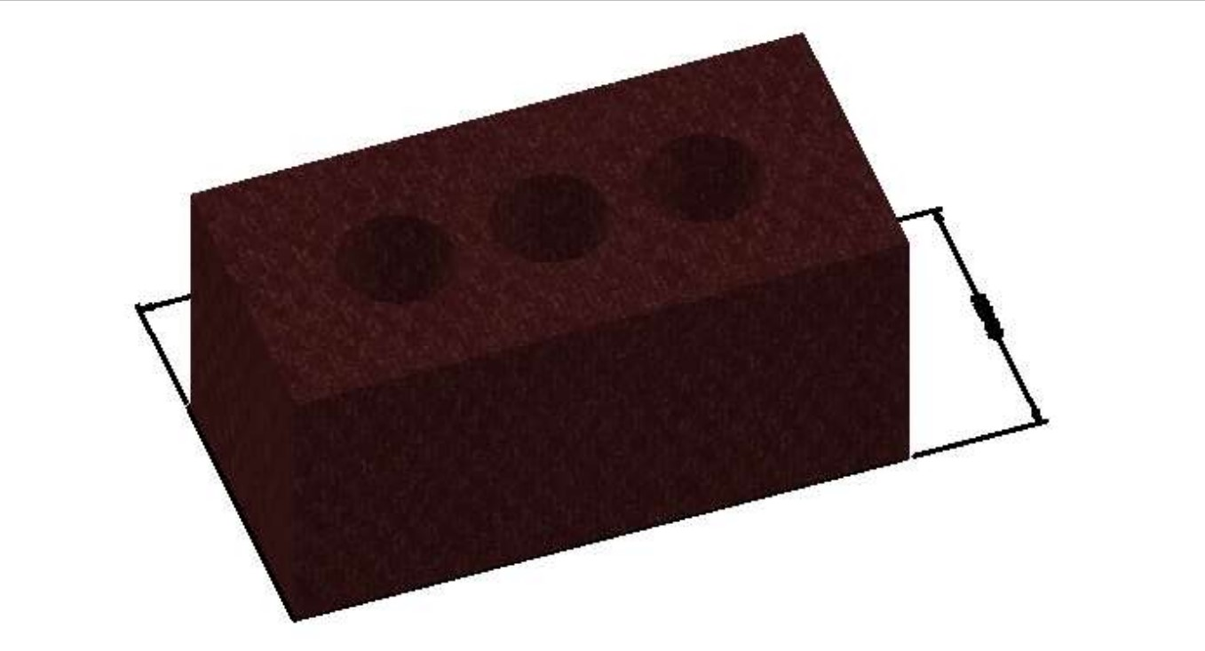
Old castle brick

Slide 8
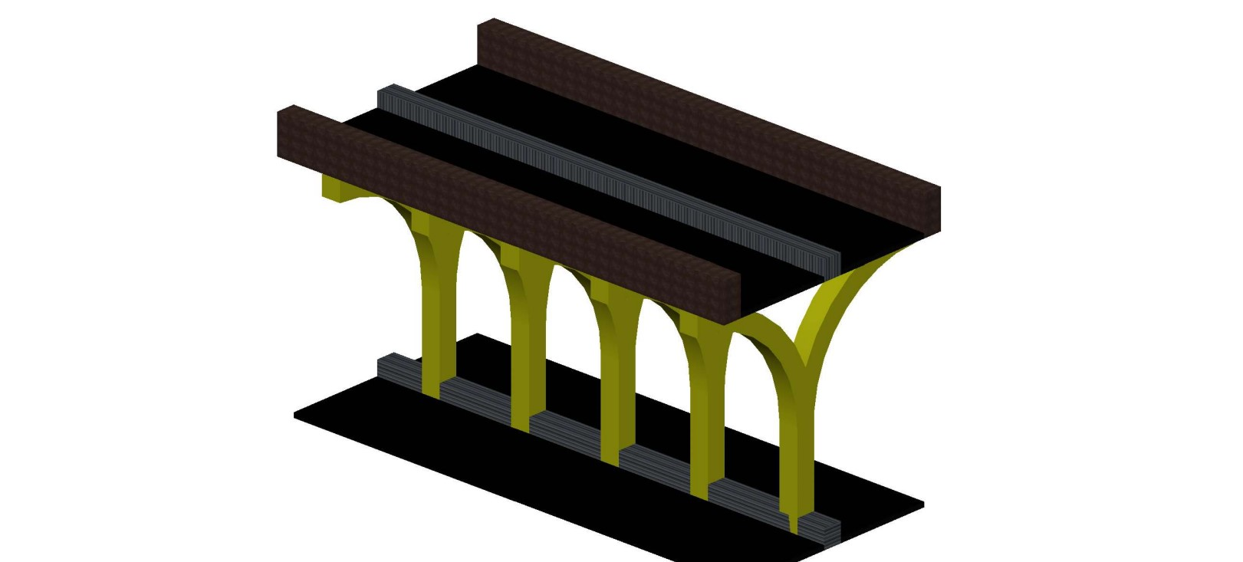
Prototype of over bridge

Slide 9
AutoCAD Working Formation
Selecting of units , limits.
Start operation by defining dimensions in 2D Drafting and drawing .
Press&Pull the 2D figure to 3-D shape by switching the workspace setting to 3-d Modelling.
Defining the offsets for round opening within the structure.
Setting the materials and colours.

Slide 10
Execution of Software Clown Model in 3-D Printing machine
After installing all required drivers and software for 3-D printing was executed on the machine and real world model was printed out.
Study of the modal/prototype is required for ensuring the usability.
Different aspects of the modal are studied for next step working.
Printed modal hence can be used for the many different studies in different dimensions.

Slide 11
Conclusion and Future Scope
Project work can be conclude in the aspect of study enhancement and future scopes can be open up from this project.
In future planning to make our project in actual levels rather then prototype in order to try and test the outputs.
Industrial collaborations are targeted to upscale the production and uses.

